Slide 1
Mark Sanders Coordinator
The FIRES Reform Strategy for Italy

Slide 2
Our Analysis
Inclusive, Sustainable and Innovative Growth requires Entrepreneurship
There is no shortage of ideas, talent and capital in Europe
Too little currently flows to (productive) entrepreneurial activity
Institutions protecting creditors, workers and inventors block these flows
Effective Reform requires a differentiated and historical approach
Effective Reform should aim to channel more capital, labor and knowledge to entrepreneurial activity
We know a lot, the challenge is to formulate effective reform proposals based on that knowledge.

Slide 3
Our Work
5 Work Packages
Historical Evolution of Relevant Institutions
What is bedrock, what is reformable?
Establish Desirability and Urgency of Transition
Why do we need/want a more entrepreneurial society?

Slide 4
Our Work
5 Work Packages
Assess the state of the Union
How do we measure how EU-ecosystems are doing?
Investigate entrepreneurial processes across VoC
Variety (VoC) in Europe
Match Policy Proposals to Policy Makers
Competenties, Coherence and Feasibility

Slide 5
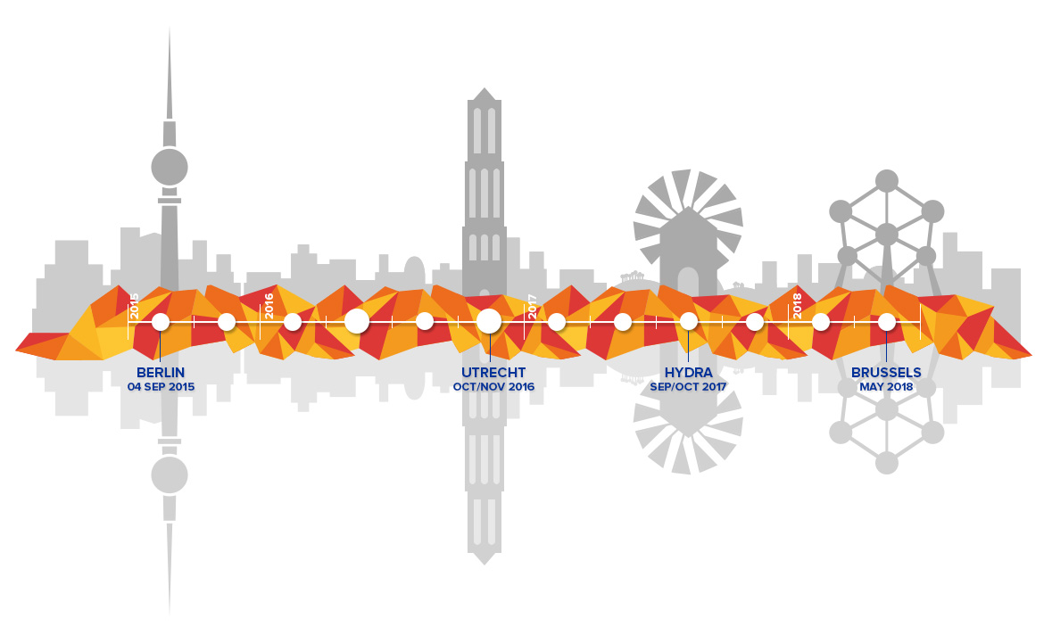
Engaging Our Stakeholders
Win over our “Enemies”
Mobilize our Allies
Share with our Colleagues
Discuss with
Policy Makers

Slide 6
The process...
The FIRES seven step approach
Step 1: Assess the most salient features of the institutional complex in place and trace its deep historical roots (WP2).
Step 2: Assess the strengths and weaknesses and flag the bottlenecks in the entrepreneurial ecosystem using a structured data analysis (WP4).
Step 3: Identify, using careful primary data collection among entrepreneurial individuals (i.e. founders) what most salient features characterize the start-up process and where entrepreneurs face barriers (D5.1).
Step 4: Map the results of step 2 and 3 onto the menu of policy interventions to identify potential interventions for the country under investigation.
Step 5: Carefully consider the list of proposals in light of the historical analysis under step 1 and fit the proposed reforms to the relevant local, regional and national institutional complex in place.
Step 6: Identify who should change what in what order for the reform strategy to have the highest chance of success (WP6).
Step 7: Experiment, evaluate and learn and return to step 1 for the next iteration.

Slide 7
The process...
So far...
1. Identify 9 most relevant institutional reform areas
2. Brainstorm and discuss with stakeholders
3. D5.12 Part I Merging 1 and 2 resulting in 64 reform proposals
4. D5.12 Part II Diagnosis for Italy (Germany and UK)
5. D5.12 From Diagnosis to Treatment
Today...
6. Present Diagnosis for Italy
7. Discuss 14 proposals for Italy

Slide 8
Diagnosis

Slide 9
The Patient
Long History
Patents, Banks, Universities
Mezzogiorno, Catholic Church
Recent History
Labour relations and welfare state
Entrepreneurship policies

Slide 10
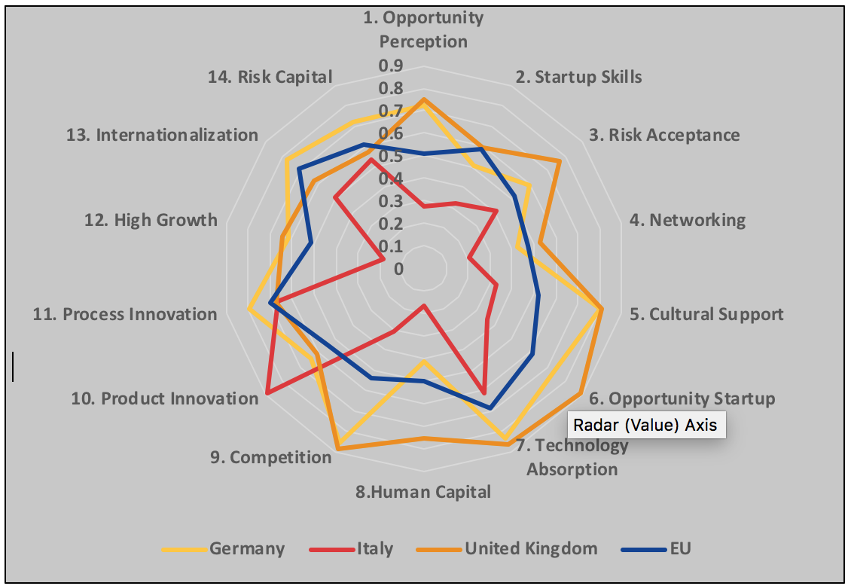
The Symptoms

Slide 11
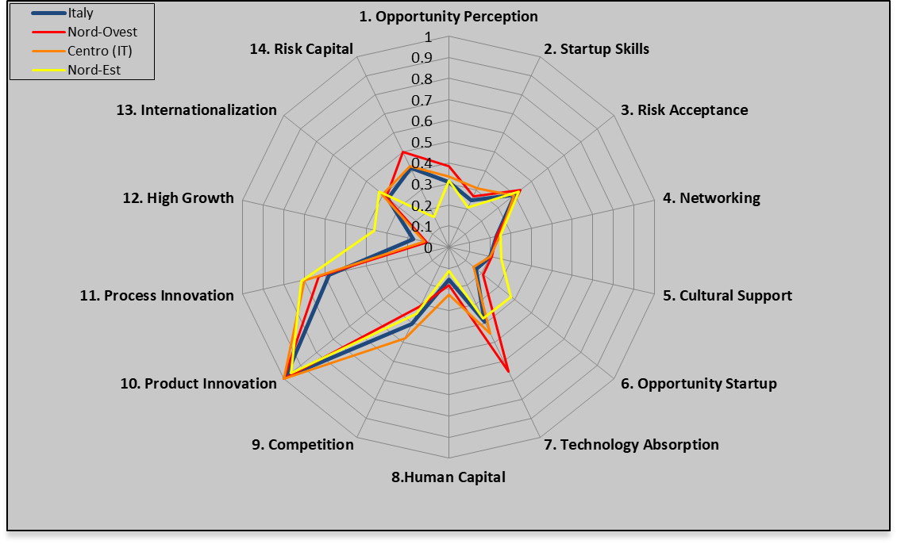
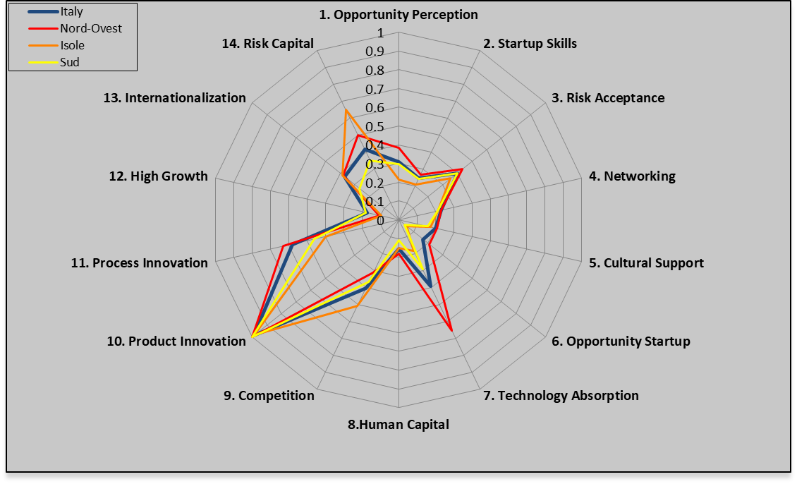
The Symptoms

Slide 12
The Symptoms (Centro)
 | PILLARS |  | INSTITUTIONAL VARIABLES |  | INDIVIDUAL VARIABLES
Entrepreneurial Attitudes | Opportunity perception | 0.34 | Market Agglomeration | 0.46 | Opportunity Recognition | 0.57
 | Start-up skills | 0.31 | Quality of Education | 0.65 | Skill Perception | 0.34
 | Risk Acceptance | 0.39 | Business Risk | 0.69 | Risk Perception | 0.37
 | Networking | 0.25 | Social Capital | 0.46 | Know Entrepreneurs | 0.37
 | Cultural support | 0.20 | Open Society | 0.35 | Career Status | 0.85
 | Entrepreneurial Attitudes 28.1
Entrepreneurial Abilities | Opportunity startup | 0.15 | Business Environment | 0.27 | Opportunity Motivation | 0.67
 | Technology Absorption | 0.45 | Absorption Capacity | 0.37 | Technology Level | 0.85
 | Human Capital | 0.23 | Education and Training | 0.45 | Educational Level | 0.39
 | Competition | 0.48 | Business Strategy | 0.90 | Competitors | 0.35
 | Entrepreneurial Abilities 29.9
Entrepreneurial Aspirations | Product innovation | 1.00 | Technology Transfer | 0.79 | New Product | 1.00
 | Process innovation | 0.70 | Technology Development | 0.57 | New Technology | 0.96
 | High growth | 0.12 | Clustering | 0.40 | Gazelle | 0.38
 | Globalization | 0.40 | Connectivity | 0.65 | Export | 0.55
 | Financing | 0.43 | Financial Institutions | 0.56 | Informal Investment | 0.64
 | Entrepreneurial Aspirations 42.6
 | REDI | 33.5 | Institutional | 0.54 | Individual | 0.59

Slide 13
Survey
Regulatory Obstacle | Times mentioned
Which regulatory requirements did you perceive as major obstacles during venture creation? | 131
None | 28
Difficulties with bureaucratic procedures | 19
No answer | 13
Taxes | 7
Difficulties with obtaining finance | 7
Lacking clarity regarding regulations | 5
Constantly changing regulatory environment | 5
Safety regulations | 5
Legal requirements to involve a notary | 4
Legal Initial Capital Requirements | 3
Specific requirements related to energy sector | 3

Slide 14
Survey
Policy Suggestions | Times mentioned
What could the government do to promote new venture creation in Italy? | 99
Reduce bureaucracy | 21
Facilitate financing for small businesses | 16
Reduce time and difficulty of bureaucracy through online procedure | 7
Provide better information about how to start a business | 7
Provide better training to people for starting businesses | 6
Reduce tax rates for small businesses | 5
Provide guidance | 4
Provide incentives for hiring people | 4
Avoid constant policy changes | 3

Slide 15
Diagnosis
Regulatory uncertainty creates sclerosis
SMEs and self-employment high, but entry/exit low
Fear of failure and lack of opportunities
Emphasis on knowledge absorption not experimentation
Human capital level high but formalized

Slide 16
Treatments

Slide 17
Proposal 1: Stable and Effective Judiciary
1 | 3.1.2 | The Rule of Law | We propose to further strengthen the current rule of law monitoring and enforcement mechanisms to ratchet up the performance of all Member States on issues related to rule of law, government effectiveness and protection of property rights. | Deficiencies in these factors negatively impact all agents in the entrepreneurial ecosystem and induce people to conduct activities and keep their capital in the shadow economy. Even the poorest EU member countries are higher medium-income countries, and neither the VoC literature nor arguments à la Rodrik (2008) provide any support for the view that these countries can compensate for these deficiencies through other institutional measures. | It takes too long to settle commercial disputes in civil cases. This creates uncertainty and works in the advantage of large, established and incumbent firms. An entrepreneurial society needs fast, predictable and clear legal proceedings to thrive. A lot has been done, but more is needed still.

Slide 18
Proposal 8 and 10: Lower and Predictable Tax Liabilities
8 | 3.2.4 | Taxation of Corporate Income | The Union should strive to reduce and ideally remove the discrepancies in member countries between statutory and effective corporate income tax rates. | Their removal would create transparency and contribute to levelling the playing field for all firms regardless of their size, age, industry or nationality. Competition among member states is good, but it should be competition on corporate tax rates and not on complex, opaque fiscal deals and schemes. Moreover, when it comes to corporate taxation, member states should treat all firms equally. | This general advice we would give to the Comission and would also apply to Italy. Founders in Italy complain about taxes but more than their level, their complexity and unpredictability makes growing a firm unattractive.
10 | 3.2.5 | Taxation of Dividends and Capital Gains | Complexities should be removed when possible. Instead, countries should aim for dividend and capital gains tax rates with few exceptions and few (opaque) concessionary schemes. | Here, the Eastern European countries, such as Poland and Estonia, have exemplary models in which the tax rates are at reasonable levels and the effective tax rate is largely independent of other circumstances. Arguably, the reason for this clarity is that the design of these systems date back no further than 1989. A radical redesign from the ground up is probably not feasible in older member states, but they should nevertheless strive for similar improvements to simplicity and transparency. | See proposal 8. A tax system benefits from an occasional cleaning-up. Simplicity and transparancy should be the goal, not necessarily reducing rates for targetted groups. But at an overall tax pressure of 64% against 40.8% in Europe, Italy should also reduce taxes.

Slide 19
Proposal 14 and 19: More Finance for Experimentation
14 | 3.3.2 | Private Wealth | Our proposal is that in regions where family ties are strong, there should be institutional arrangements that would promote lending from private funds especially from the family to ventures. | In FIRES-Deliverable 2.2 (Dilli and Westerhuis 2018) it was shown that these cross-national differences in family financing are result of the differences in extent to which individuals feel socially obliged towards their family members, shaped by the strength of family ties. These family ties are result of the historical family arrangements. As a result, the share of family financing is expected to be much higher in regions where traditionally the family group has priority over the individual (strong family ties), common in the Eastern European and the Mediterranean countries context compared to the North Western European countries where the individual and individual values have priority over family (weak family ties). | Italy has a strong family based tradition. This creates opportunities also for financing ventures, especially in their early stages. Italy could consider banking on extended family ties to increase the flow of financial resources into entrepreneurship. The Anglo-Saxon Angel and VC model may be less appropriate in the Italian context.
19 | 3.3.4 | Banking | Increase the mandatory equity ratio in banking gradually to 10-15% to have more skin in the game and allow banks to take on more risk responsibly in their lending portfolios. | Given that European banks operated profitably at much higher equity ratios in the past whereas non-European banks continue to do so, this proposal only requires a sound implementation and transition strategy. Gradually building up the equity buffer while at the same time accumulating more publicly guaranteed SME-loans in the portfolio is a balanced approach. Higher required equity buffers will increase the price of credit and some might argue that this will reduce credit and investment in the aggregate. We feel, however, that such price increases will only drive out the marginal investment projects and most of these are currently found in the secondary, speculative investments that Bezemer (2014) deems unproductive. | Italy still has a rather diverse and locally embedded banking system. This can be an asset in the entrepreneurial society, but these small, local banks are increasingly brought under European rules and supervision made for large, system banks. By requiring higher equity in banks, they can justifiably engage in riskier but also in the long run more productive lending.

Slide 20
Proposal 28, 31, 32 and 35: Mobile Labour Force
28 | 3.4.2 | Employment Protection Legislation | CMEs can provide a model for MMEs, which show more similarities to CMEs in many respects than LMEs. | Less regulation on permanent employment is likely to be linked with high-growth aspirations among entrepreneurs particularly in the Mediterranean Market Eeconomies (MMEs) whereas no change is observed in the other institutional constellations. Given that Coordinated Market Economies (CMEs) are shown to perform rather well in innovative entrepreneurial activity, while being characterized by moderately liberal labor market institutions, centralized wage setting institutions and high levels of social security. We therefore conclude that a policy of radical liberalisation following the Liberal Market Economies (LMEs) model is perhaps not the only way. | Italy has already implemented some fundamental reforms in the labour market in recent years. In part this was done under pressure of the financial and eurocrisis and external creditors. The general direction of these reforms was right, but Italy should not forget that of the MMEs it is actually closest to the CMEs and should seek to combine flexibility with social security.
31 | 3.4.3 | Employment Protection Legislation | Establish or strengthen training programs to prepare workers for new occupations | Archanskaia et al. (2017) show that countries with a low rate of substitution between inputs in routine production, will not be able to gain a comparative advantage in high-value products that are intensive in non-routine tasks. As a result, they will end up specializing more and more in routine-intensive products and experience lower wage growth. Geurts and Van Biesebroeck (2016) further show that the pattern of firm-growth in Belgium indicates that young firms under-adjust to good news. As a result, many promising firms scale up too slowly and they might miss out on opportunities in a fast-paced global market. | In a more flexible labour market, more flexible and mobile employees are key. Italy will not be isolated from technological and economic trends and flexibility is needed to engage opportunities and exit declining jobs, industries and trades. We propose Italy invests in the flexibility of its workforce.

Slide 21
Proposal 28, 31, 32 and 35: Mobile Labour Force
32 | 3.4.4 | Confidentiality Agreements and Barriers to Mobility | To promote the mobility of people and their knowledge across firms, we propose to lift the legal enforceability of confidentiality agreements between employers and their employees. | Of course, there can be justified instances in which confidentiality is needed to protect the legitimate interests and privacy of customers, but confidentiality agreements and especially non-compete clauses are more often used to prevent knowledge from flowing freely between firms and sectors. | Specifically for Italy, this proposal should be understood in light of the two above, arguing for investment in mobility and reducing barriers for switching jobs, industries and occupations. This will create opportunities for the young and talented to remain actively engaged in Italy and reduce the brain drain to the rest of Europe. Specifically the "reinstatement" provision in employment protection is often mentioned as a burden on small and young firms.
35 | 3.4.5 | Social Insurance Systems | Embracing the principles of flexicurity, we propose to carefully consider the impacts of reforms on young SMEs and not force them to take on high risks and burdens. | The general guiding principles the European Commission have formulated do not include structural and careful attention to what such reforms would mean for start-ups and young SMEs. While the specifics can and will vary country by country, we can infer that an important component of a policy that makes society more innovative and entrepreneurial involves making the individual’s social insurances as portable as possible when changing jobs and moving between salaried employment and self-employment. | It is tempting for governments with tight budgets to have employers pick up the bill for their employees' social security. This, however, tends to reduce mobility and strengthens the insider-outsider effect. On the labour demand side, such schemes work in (relative) favour of large firms and blocks young firms expanding. This keeps youth unemployment up and pushes also educated Italian youngsters to leave.

Slide 22
Proposals 40, 45 and 48: Managing Regulation
40 | 3.5.2 | Product Market Regulation | Excessive barriers to new business formation and new entry should be lifted where possible. | This, however, seems to be part and parcel of the EU policy agenda already. Our consortium supports that effort with the caveat that well justified barriers to entry are useful to keep unproductive or even destructive ventures out (Stenholm et al. 2013; Darnihamedani et al. 2018). It should be easy for challengers to enter (and exit) but these challengers should be serious. | Key in this proposal is "excessive". Founders in Italy report quite a wide variety of bureaucratic and administrative barriers to starting up a venture in Italy. Some of these barriers may serve a valid purpose, but simplicity, transparency and predictability are then required also. Data shows Italian SMEs spend 52% more time dealing with bureaucracy than their European competitors and WEF ranks Italy 44th on doing business index. There is a lot of room for improvement.
45 | 3.6.3 | Knowledge Diffusion after Failure | We propose to set up publicly funded “entrepreneurial knowledge observatories” | Our consortium agreed that a lot of useful knowledge, perhaps of a more applied and tacit nature, is generated in the entrepreneurial process, particularly when ventures fail. That knowledge is lost when entrepreneurs do not share their experiences. However, as that is not their core business and private incentives are absent, it makes sense to publicly fund the collection, curation and diffusion of that knowledge. | Creating a real hub, rich in events, infrastructure, and networking between teams could be useful for the Italian Startup Ecosystem. This involves concentration. Today Milan (14,7%), Rome (8,5%) and Turin (4,7%) have less than 30% of the total number of startups (and these data are flattered). Our research has shown how geographical proximity is important for success. It is a tough choice, but it would be useful to invest in a start-up capital (Milan) with a national function.
48 | 3.7.2 | Knowledge Generation | Both the EU and its member states should create healthy, well-funded, academic institutions. | In the literature, there is also broad consensus that basic research is a pure public good (Salter and Martin 1991; Pavitt 1991). It therefore makes perfect sense to channel more of the EU budgets to an activity that provides such evident positive spillovers throughout the Union. | For the Italian context it is important to open up its academic institutions. Many reforms have already been undertaken, but most in a time of ageing, financial constraints and budget cuts. With vested interests and gilded contracts hard to reform, the rate at which Italian academic institutions open up for competition and meritocracy is slow. It makes little sense to spend a lot of money on institutions before such structural issues have been addressed. Unfortunately the (poor) students, not the ageing staff is driven out.

Slide 23
Proposal 55, 57 and 59: Entrepreneurial Educational System
55 | 3.8.2 | Creativity in primary and secondary education | Push for reforms in primary and secondary education that promote creativity, a willingness to experiment, a tolerance of failure and out-of-the-box thinking. | More appreciation for creativity (and therefore tolerance of deviant behaviour) will probably shift the balance from business oriented to more creative entrepreneurship. Evidence from field experiments (Weitzel et al. 2010; Urbig et al. 2012) and in the FIRES-project (Lauritzen et al. 2017) suggest that creative entrepreneurs are more socially oriented than strictly business-oriented entrepreneurs. Promoting creativity in primary and secondary education, to the extent possible, is therefore a long-term strategy to promote productive entrepreneurship that will create innovative, sustainable and inclusive growth (Stam et al. 2012). | Italy's educational system can be characterised as traditional. The State sets the curriculum, provides uniform tests and most children attend public schools. The curriculum is demanding, geared towards cognitive skills and textbook based, leaving little room for creativity and diversity. Italy considers its educational system of high quality, but making pupils work hard is not the same as teaching them useful skills. Countries ranking high on e.g. the WEF, OECD and EU rankings, such as Finland and Norway have less homework and formal testing and more autonomy for highly trained and well paid professionals.

Slide 24
Proposal 55, 57 and 59: Entrepreneurial Educational System
57 | 3.8.2 | Education in the Entrepreneurial Society | To promote the integration of Europe’s knowledge base we propose to make English the (mandatory) second language and promote its instruction in primary and secondary education systems throughout the European Union. | We would like to stress, however, that we do not see this as part of building a European identity or culture. Rather, as a tool to enable citizens in the Union, and in particular those that end up in business and/or science, to exchange knowledge efficiently and effectively. Effective communication requires a common language and English qualifies as the Lingua Franca of modern science in most academic disciplines as well as global business. | Italy ranks 20 out of 27 EU countries plus Turkey when it comes to knowledge of English as second language. This is a handicap when Italy seeks to compete at the EU or global level.
59 | 3.8.4 | Universities | We propose to educate the young and bright minds of Europe how to be more entrepreneurial before they make their career choices. | Recognizing the importance of this European model of knowledge diffusion, European universities can take a larger role in the transition to a more Entrepreneurial Society in Europe. This starts with simple no-regret policies that have been proposed before (i.e. the European Commission’s Entrepreneurship 2020 Action Plan). | Many universities started offering courses focused on startups. Courses usually taught by a researcher with no work experience outside academia, and clearly no past in startups. With the average curriculum dealing with business plans and how to get financing. We lack a startup culture and those trying to provide it have no idea what they are talking about. We are still in the phase where everyone is teaching and few doing.

Slide 25
Proposal 80+: Do not be afraid to try something new

Slide 26
Our Questions
Would you agree with our approach?
Would you agree with our diagnosis?
Would you agree with the proposed treatment?
And specifically:
a) Which proposal(s) among the ones proposed by FIRES, you would support and endorse and, conversely, which one (if any), you would disregard?
b) Is there any policy proposal for the Italian entrepreneurial ecosystem that you would recommend to include that it is not mentioned in the FIRES policy brief?
c) Can you please gauge about the political feasibility of the FIRES proposal(s) that you like. Are they easily implementable or not? Do you see any difficulties or obstacles of any sort, and in particular political obstacles, to implementing the proposed recommendation(s)?

